Slide 1




www.activelivingresearch.org
An Active Living Program supported by The Robert Wood Johnson Foundation and administered by San Diego State University.
Increasing Physical Activity
At School: Evidence-Based
Approaches
James F. Sallis, Ph.D.
San Diego State University
www.activelivingresearch.org

Slide 2






Slide 3
Troiano, MSSE, 2007

Slide 4
Evidence-Based Strategies to get children more active in schools
  Physical Education
  Classroom activity breaks
  Policy & Environmental Changes
  Active commuting to school
  After-school programs
  Community use of school facilities
  Health Education Curricula

Slide 5
Importance of PE
One time during day all children, regardless of race/income, can be active
If child has no access to park or sports, PE is only opportunity for activity
Importance of PE recognized by:
  Institute of Medicine Report on Childhood Obesity
  Centers for Disease Control

Slide 6
Benefits of PE
Mental and physical health
Obesity prevention, weight loss maintenance
Academic performance
Concentration
Class room behavior
Opportunity to learn
  Social skills & Teamwork
  Discipline

Slide 7
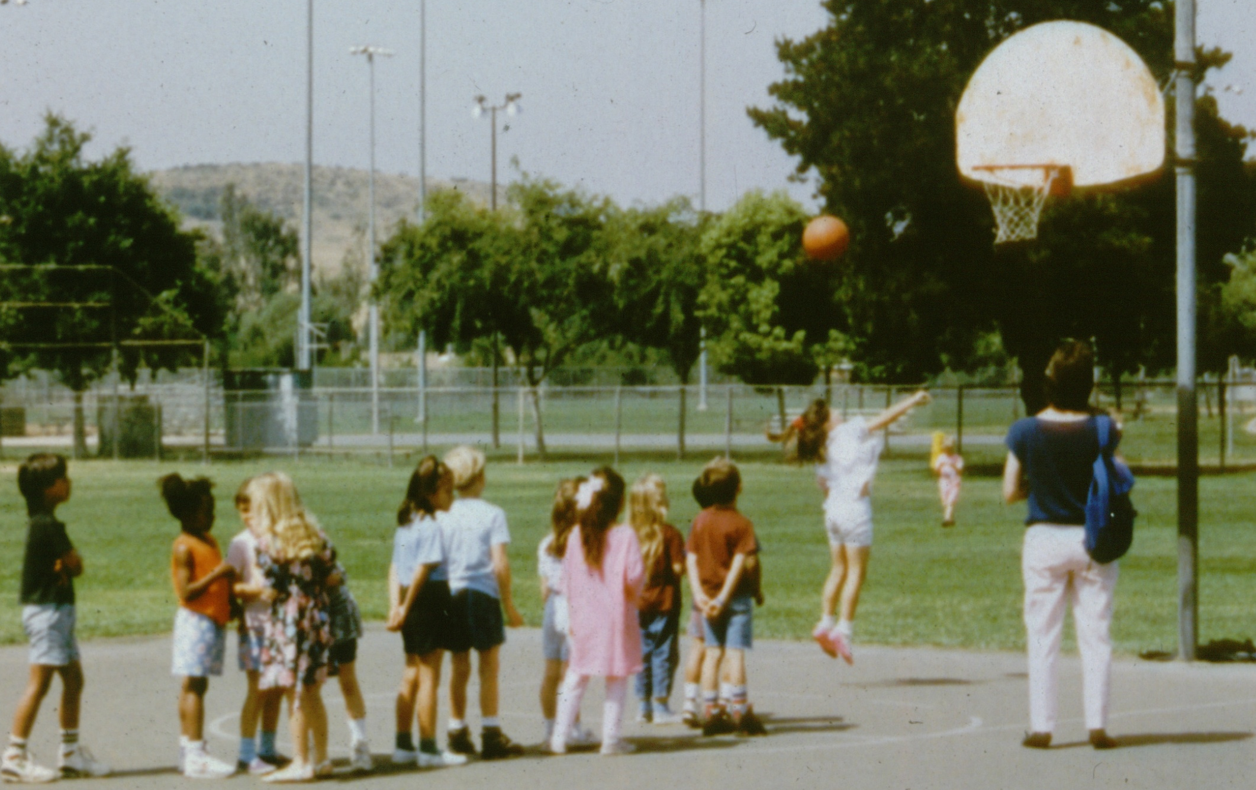
What PE is—too often

Slide 8
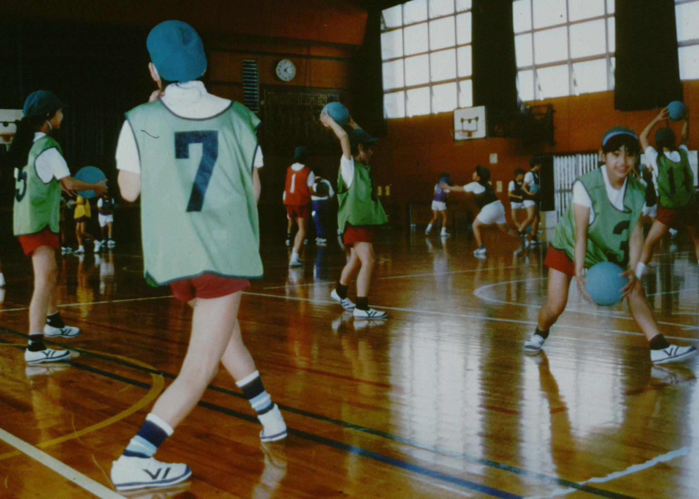
What PE should be

Slide 9
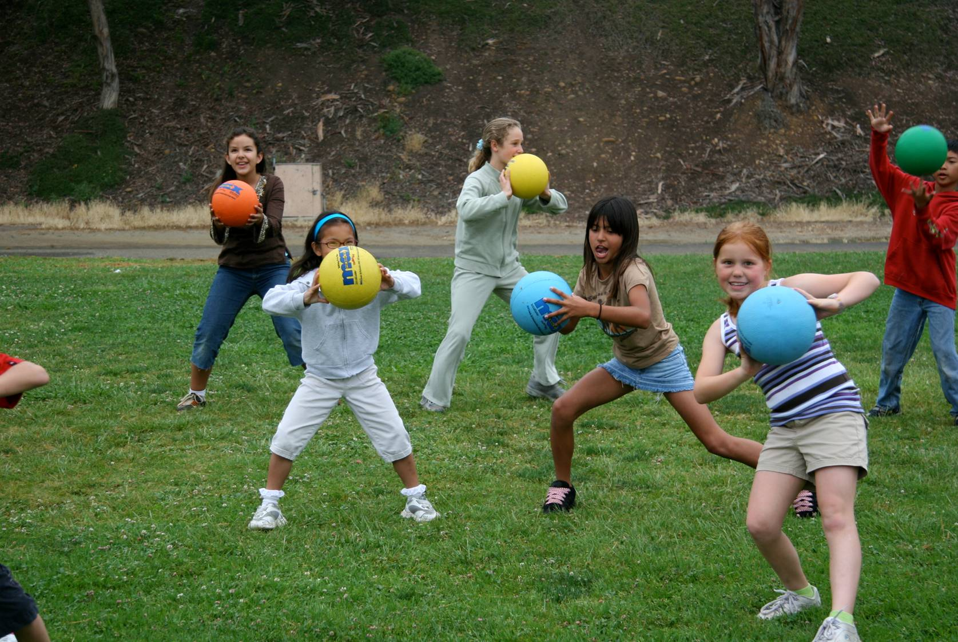
All Kids Should Be Active in PE
(50% of class time)
And Learn Skills

Slide 10
PE classes in lower income schools spend less time being active.
Yancey. www.calendow.org

Slide 11
Avg. amount of PE class time in MVPA
by class size (secondary schools only)
N=6
N=12
N=12
N=10
Class Size
The amount of P.E. class time that students were physically active was less in larger classes.

Slide 12
Evidence-based PE is Available
Elementary schools
Middle schools
High schools
CATCH
SPARK
M-SPAN (SPARK)
TAAG
LEAP

Slide 13
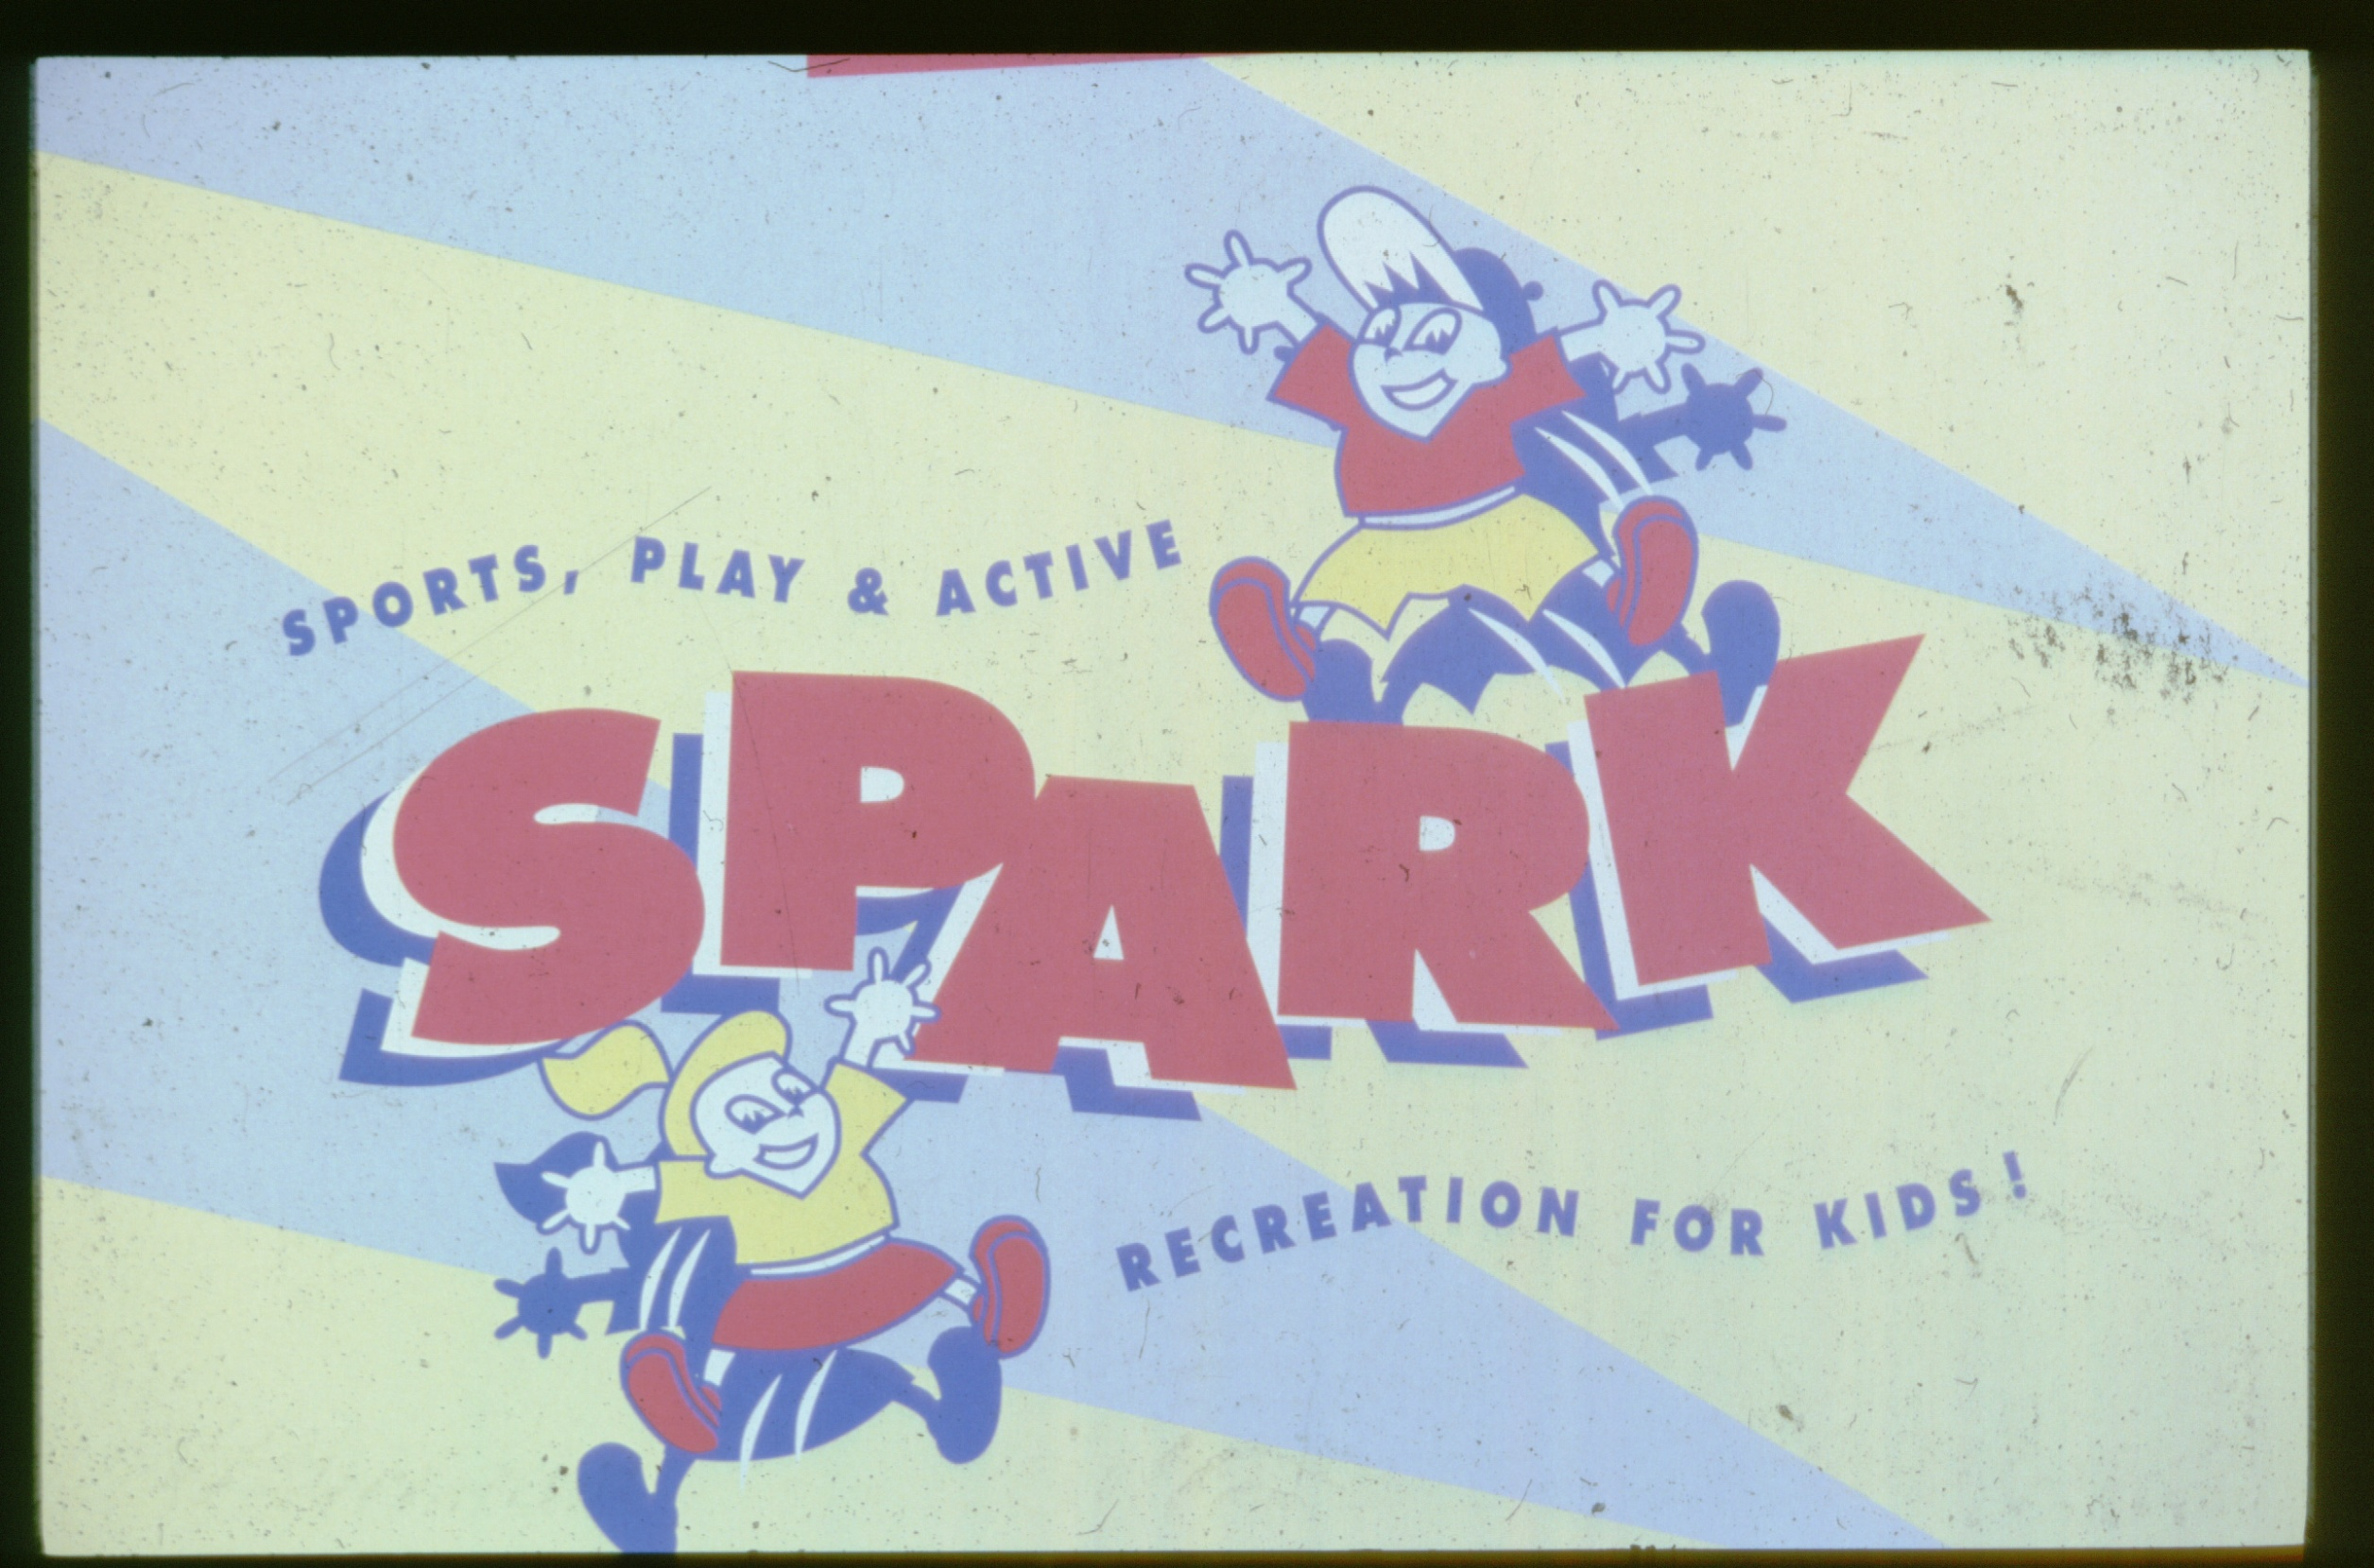
www.sparkpe.org

Slide 14
SPARK Intervention
PE classes emphasize
  Movement for all
  Sports skills
  Enjoyment
Self-management classes
  Taught behavior change skills
  Included weekly activity goals
  Involved families
Staff development prepared teachers to implement the curricula

Slide 15
Physical Education
“Hall of Shame”
Standing in line waiting for a turn
“Picking” teams
Using activity to punish students
Focusing on star athletes
Grouping by gender
Sharing 1 ball with 30 close friends
Big people throwing balls at little people!

Slide 16
So What is Good PE?”
Inclusive
Highly Active
Success in learning sports skills
Fun!

Slide 17
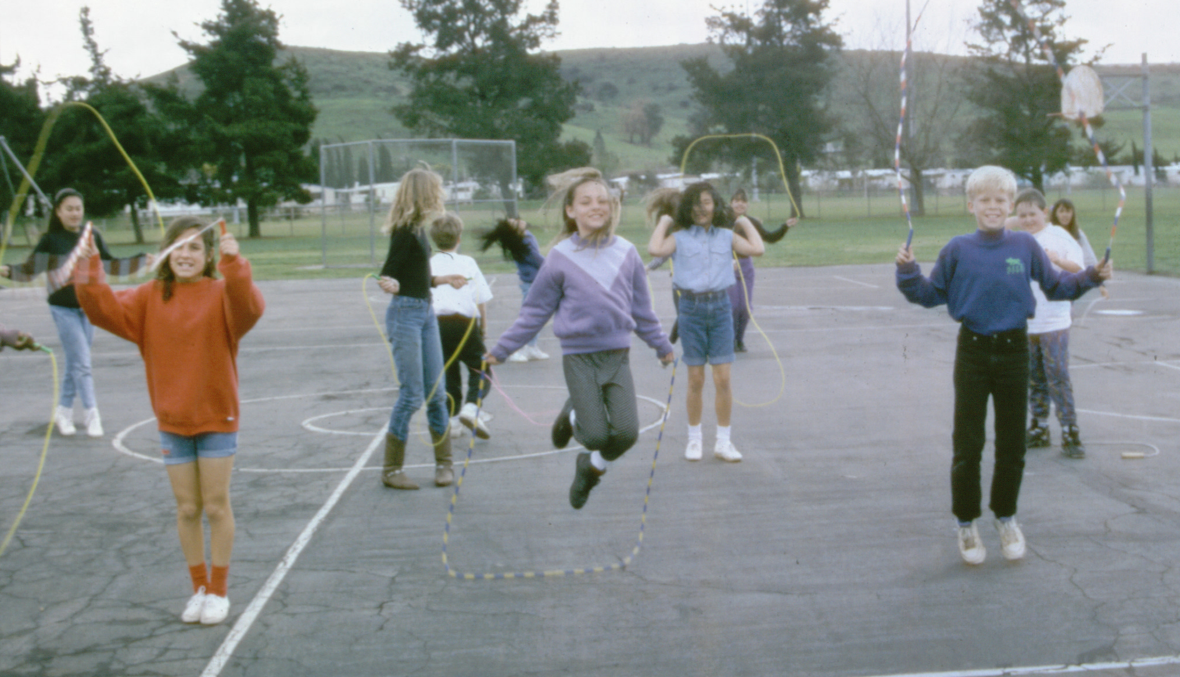
Part 1: Health-Related Fitness Activities

Slide 18
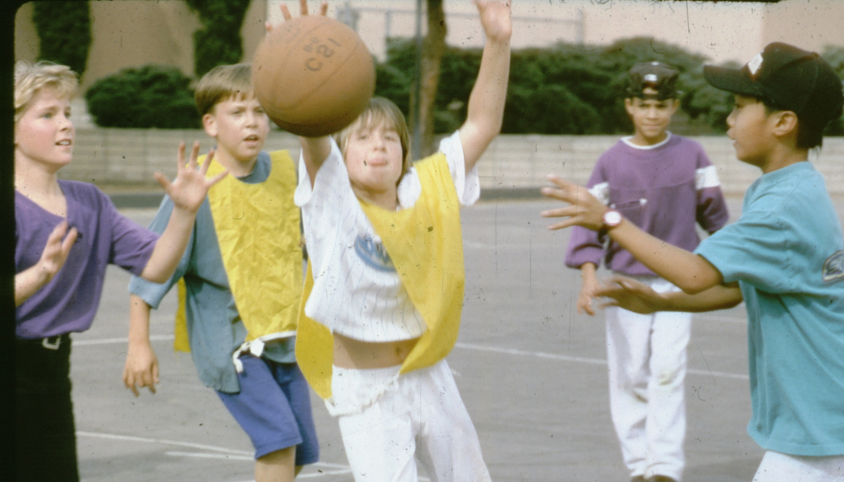
Part 2: Skill-Related Activities

Slide 19
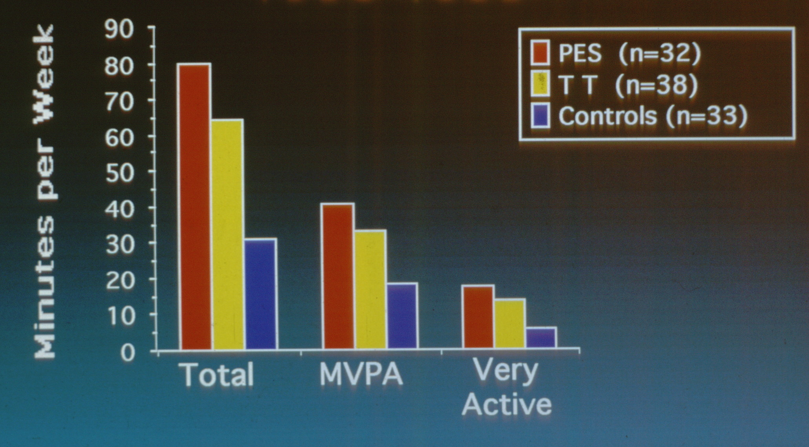
SPARK Effects on PE Class Time & Observed Physical Activity

Slide 20
Motor Skill Gains: SPARK
Percent Gain
Catch, throw, & kick gains after 6 months
(McKenzie et al., 1998; JTPE)

Slide 21
Boy’s Sit-Ups
Number / Minute
Month
(Sallis et al., 1998; AJPH)

Slide 22
Effects on Academic Achievement
3-Year Changes in Percentile Rank
  Comparing SPARK & controls on standardized tests:
  -4 better, 1 worse, 3 no difference
  Increasing PE from 32 to 98 or 109 min/week did not reduce academic performance
(Sallis et al, RQES, 1999)

Slide 23
SPARK Outcomes
PE specialists>trained classroom teachers> controls
Improved quality of PE instruction
Increased physical activity in PE
Improved cardiorespiratory & muscle fitness
Improved sports skills
Positive impact on academic achievement
Students enjoyed SPARK lessons

Slide 24
SPARK Dissemination
Since 1994 we have been training teachers to use SPARK
Programs offered
  Early Childhood thru High School PE
  Active Recreation
900 trainings annually; 1000s of schools
>1.5 million children per day in SPARK

Slide 25
Sustainability of SPARK
Independent evaluation conducted by U. of South Carolina
Mailed survey completed by teachers at 111 schools
75% used SPARK more than 2 years
SPARK users taught PE more frequently (3.4 days/wk) than non-users (2.7 days/wk)
Res Quart Exerc Sport (Dowda et al, 2005)

Slide 26
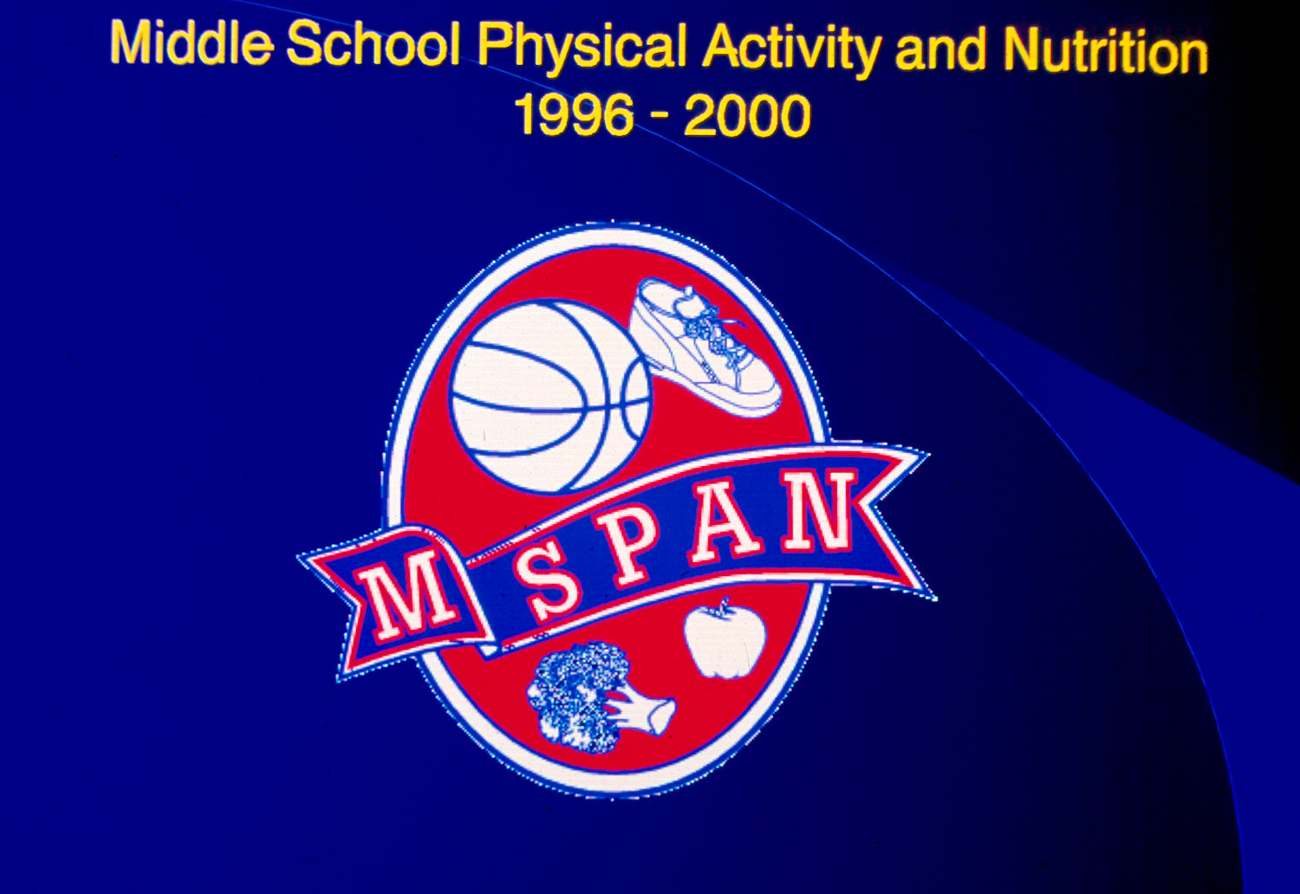

Slide 27
M-SPAN: Effects on MVPA in PE
(b) p=.009; d=.98
MVPA Min Per Lesson
(g) p=.08; d=.68
N=12 Intervention & 12 Control Schools; 1847 lessons

Slide 28
Creating Activity-Friendly School Environments
Recess is more active when there is equipment & trained supervisors
Equipment and supervision can be effective before school, after lunch, & after school
Playground markings can stimulate more activity

Slide 29
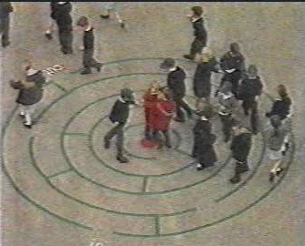
Improving activity during recess
Stratton et al. from the UK conducted several studies showing simple markings on elementary playgrounds increases PA about 18 min/day

Slide 30
Mahar, Murphy, et al., Medicine and Science in Sports and Exercise, 2006

Slide 31
Summary
Step 1 is to make sure students have PE every day
Step 2 is to make sure PE classes are active & fun
This requires teacher training, time in the schedule, & sufficient equipment and space
We know how to make school PE better; now we need political will & resources
Classroom activity breaks get students more active & improve academic achievement
Supervision & equipment make recess more active for children

Slide 32
Resources
SPARK PE
  www.sparkpe.org
CATCH PE
  http://www.catchinfo.org/aboutusmain.asp
Research briefs on improving PE
  http://www.calendow.org/Article.aspx?id=3920
Research brief on PE link with academics
  http://www.activelivingresearch.org/files/Active_Ed_Summer2009.pdf

Slide 33
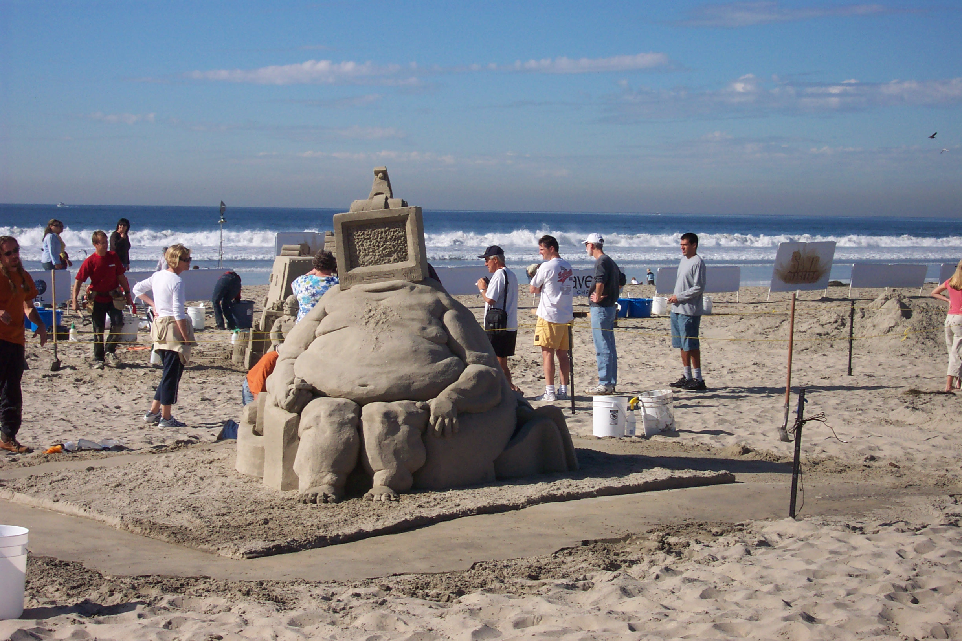
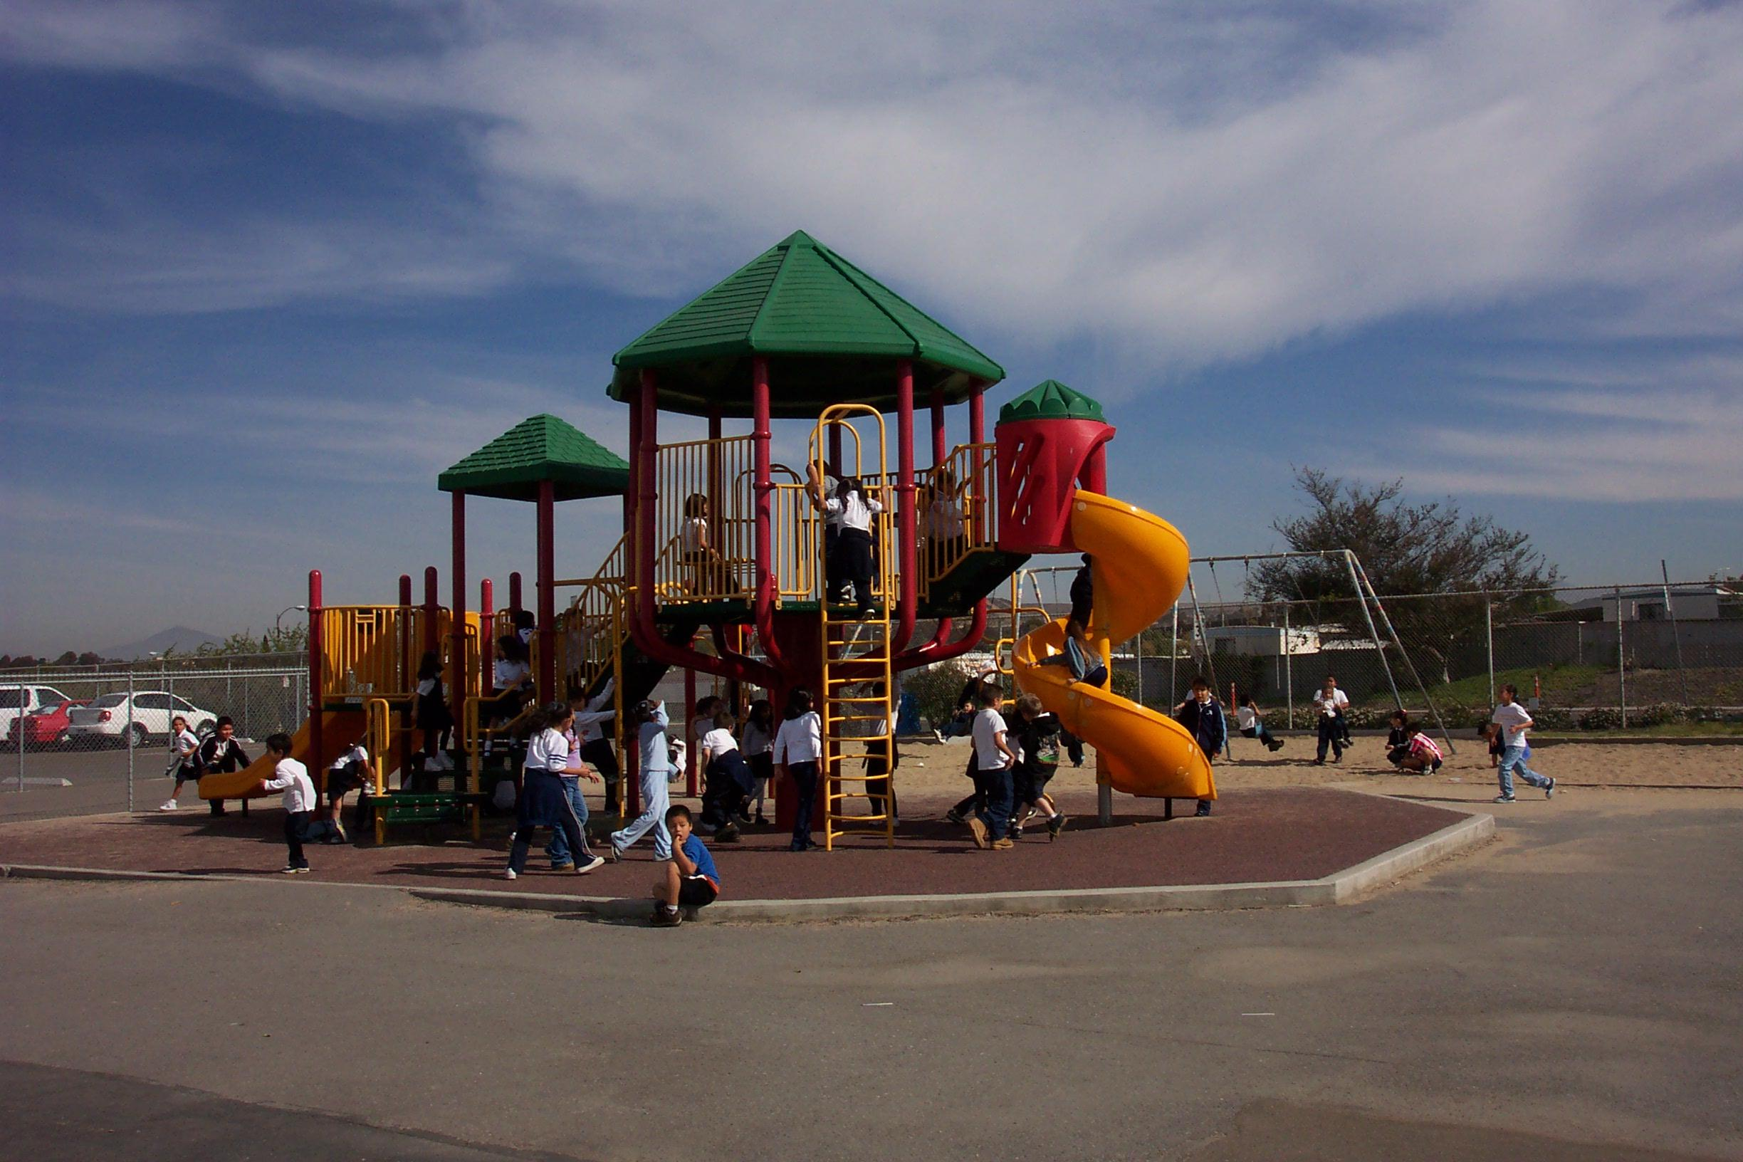
My Vision for
The Future
Less of this
More of this
www.drjamessallis.sdsu.edu www.sparkpe.org

