Slide 1
Opportunities for Improving Physical Education’s Impact on Public Health
James F. Sallis
San Diego State University
www.drjamessallis.sdsu.edu

Slide 2
20 years later—how can we do better?
Celebrate our accomplishments but resolve to improve PE for all
Remaining barriers to improving PE
  PE & public health still do not share goals for active PE
  We don’t know what is happening in PE classes
  There are disparities in PE
I propose pathways toward solutions for each of these

Slide 3
Troiano, MSSE 2007

Slide 4
  PE & public health still do not share goals
Public health has embraced PE
  IOM, CDC, CPPW, RWJF, The First Lady are your friends. They all want active PE
Education groups do not support PE
  NCLB was a disaster for PE
  Prospects for PE/PA in reauthorization are not good
  PEP grants are essentially gone
Education & PE groups do not support active PE
  Only 6 states have policies requiring 50% MVPA in PE classes. No states provide funding or accountability

Slide 5
PE & public health still do not share goals
The Virginia case study
  Both houses of the Virginia legislature passed a law requiring schools to provide 150 min of PA weekly as part of the fight against childhood obesity
  Education groups fought against the bill; health groups fought for it
  On March 24, Gov McDonnell used his first veto on this bill
  “Gov’t cannot just pass legislation and make this problem go away. Kids need to get off the couch”

Slide 6
PE & public health still do not share goals
What can we do?
  NASPE and CDC work together to set goals for 50% MVPA in PE and to achieve other goals through activity
  PE and public health work together to pass more state laws requiring active PE. This requires bringing education, PE, & health leaders together. California Endowment is pursuing this.
  Public health agencies provide partial funding to improve PA in PE. Justified because health would benefit.
    Could happen through Community Transformation Grants.

Slide 7
We do not know what is happening in PE classes
We have never had a national study of PE practices
Teacher or administrator reports of MVPA time are not credible
We have the methods—observation, sensors
The study would need to include analysis of resources for PE
  Teachers, training, equipment, facilities, class size
Also, teachers need to be able to assess MVPA

Slide 8
Avg. amount of PE class time in MVPA
by school level in 77 CA schools. (Toni Yancey)
School Level
The amount of P.E. class time that students were physically active was slightly higher in higher grades but there was a great variation within each school level.

Slide 9
We do not know what is happening in PE classes
What can we do?
  CDC leaders want to do a national PE study. They just need to find the funds. Encourage them.
  Teachers need tools to know if their kids are active enough in class.
  Phil Scruggs showed that simple pedometers can be used to monitor MVPA in PE classes. This is a feasible method for accountability. Start a grassroots movement to use them. Share experiences on PE Central.

Slide 10
There are disparities in PE
The same schools with low MVPA in PE also have
  Lower academic achievement
  Higher obesity
Perhaps improved PE can be a partial solution for several problems

Slide 11
PE classes in lower income schools spend less time being active.
Toni Yancey. www.calendow.org

Slide 12
Relation between PE Quality (%class time in MVPA)
& API Score in High & Low SES Schools

Slide 13
% PE class time in MVPA by % FRPL-eligible
& by district avg. Fitnessgram score

Slide 14
There are disparities in PE
What can we do?
  If we can bring back PEP grants, target them to schools of high need
  Target state PE funds to schools of high need
  Build capacity for low-resource schools to apply for grants and fund-raise for PE

Slide 15
Reasons for optimism
Concerns about childhood obesity are getting us closer to action
Strong interest in PE among public health groups
We know how to make PE active: evidence-based programs
Possible funding & changed incentives through Affordable Care Act

Slide 16
Here is my plea
PE and public health fields join together in demanding active PE
Document MVPA in classes, schools, and in a national study
Start improvements in schools with high need
Organize advocacy at district, state, federal levels
Get parents angry and then involved
Support kids to testify to decision makers

Slide 17
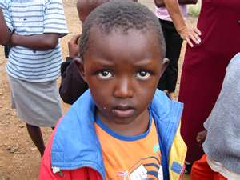

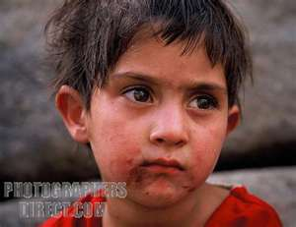

Who Can Say “No” To These Children Asking for Better PE?

Slide 18
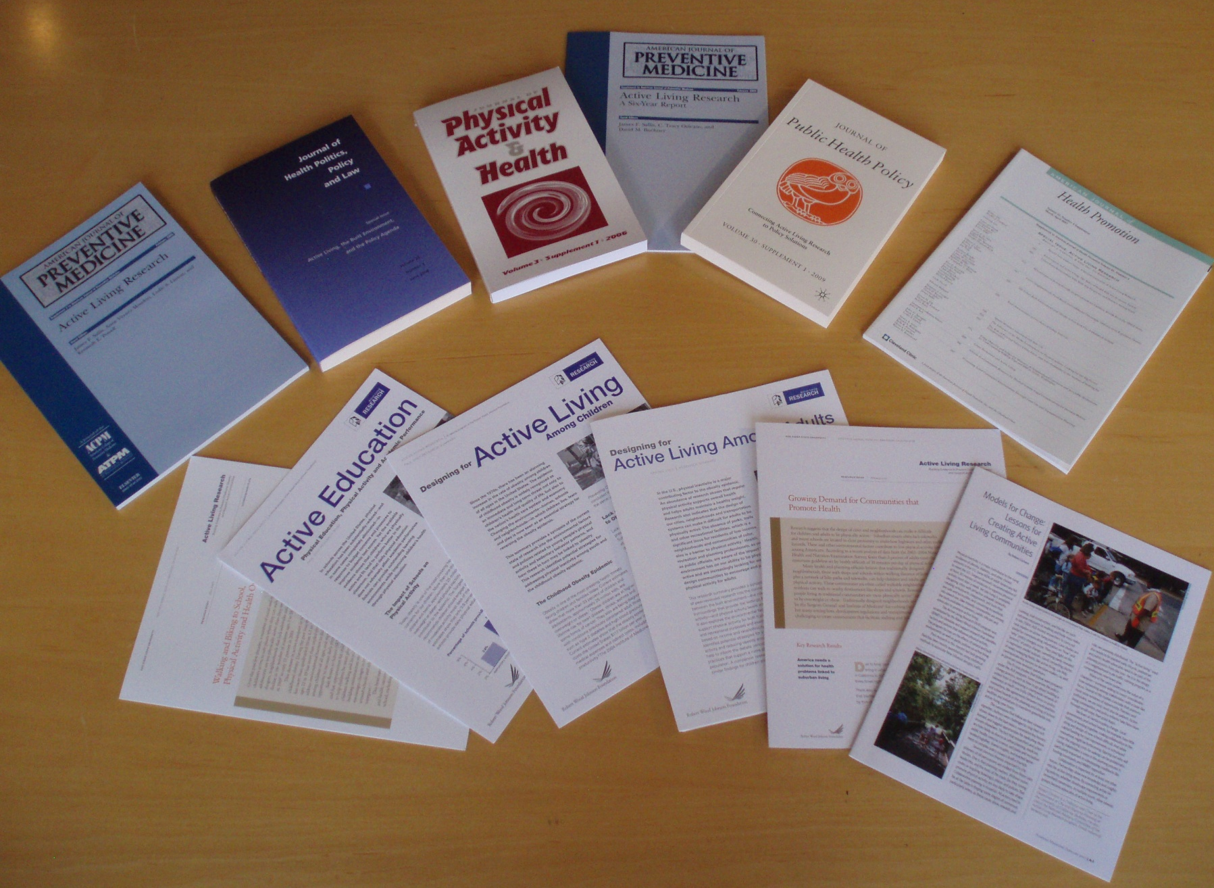
Resources at www.activelivingresearch.org

